Slide 1

6th Grade Accelerated Math
Unit 15, Lesson 1 Exploring Sample Space Volume 2, pg. 401

Slide 2


Benchmark
MA.7.DP.2.1
Determine the sample space for a simple experiment.
volume 2, pg. 401

Slide 3
Integrated Mathematical Thinking and Reasoning Standards
MA.K12.MTR.1.1 Actively participate in effortful learning both individually and collectively.
MA.K12.MTR.4.1 Engage in discussions that reflect on the mathematical thinking of self and others.
MA.K12.MTR.7.1 Apply mathematics to real-world contexts.
volume 2, pg. 401

Slide 4

Learning Targets
I can determine all possible outcomes of a given scenario.
I can determine whether or not a simple experiment is fair.
volume 2, pg. 401

Slide 5

Warm-Up
volume 2, pg. 401

Slide 6
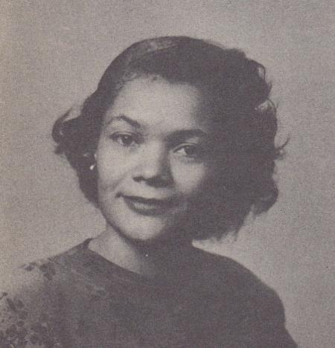
15.1.1 Warm-Up: Carolyn Beatrice Parker
Carolyn Beatrice Parker, born in Gainesville, FL in 1917, was the first African American woman known to receive a graduate degree in physics and subsequently work on the top-secret government project known as the Manhattan Project. Before earning her master’s degree in physics, she earned a master’s degree in mathematics and was also a teacher in Florida.
In 2020, an elementary school in Gainesville, FL was re-named in her honor. At this time, 11 of the 21 elementary schools in the Alachua County Public School system were named after people.
volume 2, pg. 401

Slide 7
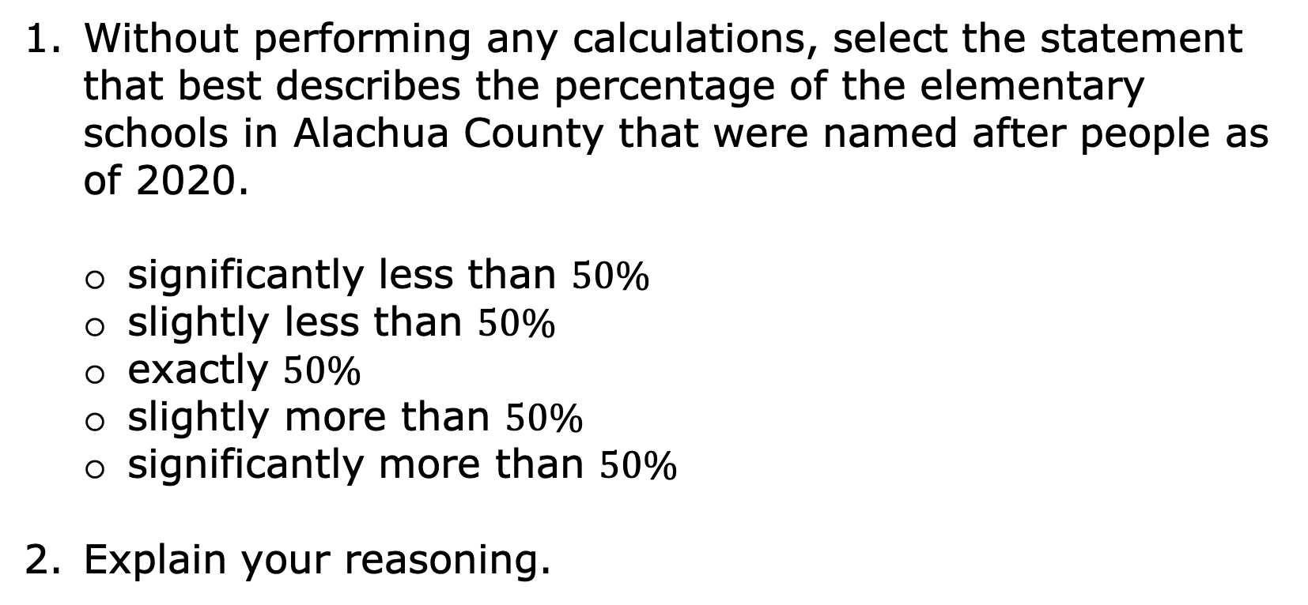
Without performing any calculations, select the statement that best describes the percentage of the elementary schools in Alachua County that were named after people as of 2020.
significantly less than $50\%$
slightly less than $50\%$
exactly $50\%$
slightly more than $50\%$
significantly more than $50\%$
Explain your reasoning.
volume 2, pg. 401

Slide 8

Guided Instruction
volume 2, pg. 402

Slide 9
15.1.2 Guided Instruction: Determining Outcomes
An outcome is a possible result of an experiment.
A spinner divided into four equal areas is shown.
How many outcomes are there from spinning the spinner?
volume 2, pg. 402

Slide 10

With your partner, discuss the sample space for the spinner. Write a list of the possible outcomes.
In a probability model for a random process, the sample space is a list of the individual outcomes that are being considered.
volume 2, pg. 402

Slide 11
How many outcomes are included in the event that the spinner lands on blue?
Primary colors include yellow, blue, and red. How many outcomes are included in the event that the spinner lands on a primary color?
An event is a set of possible outcomes resulting from an experiment. In general, an event is any subset of a sample space.
volume 2, pg. 402

Slide 12
Doug’s parents created a set of cards with chores on them. Each Saturday, Doug chooses a card to determine his chore.
Mow the yard |  | Dust and vacuum the house |  | Clean the bathrooms |  | Clean your bedroom
Clean your bedroom |  | Mow the yard |  | Weed the garden |  | Mow the yard
Clean the bathrooms |  | Parents’ choice |  | Dust and vacuum the house |  | Free day
volume 2, pg. 403

Slide 13
What are the possible outcomes for the chore cards?
Which outcomes have more than one card?
volume 2, pg. 403

Slide 14
On a particularly hot Saturday, Doug is hoping he doesn’t select an outdoor chore. Which outcomes could be included in the event that he chooses an outdoor chore?
How many outcomes could be included in the event that Doug chooses an indoor chore?
volume 2, pg. 403

Slide 15
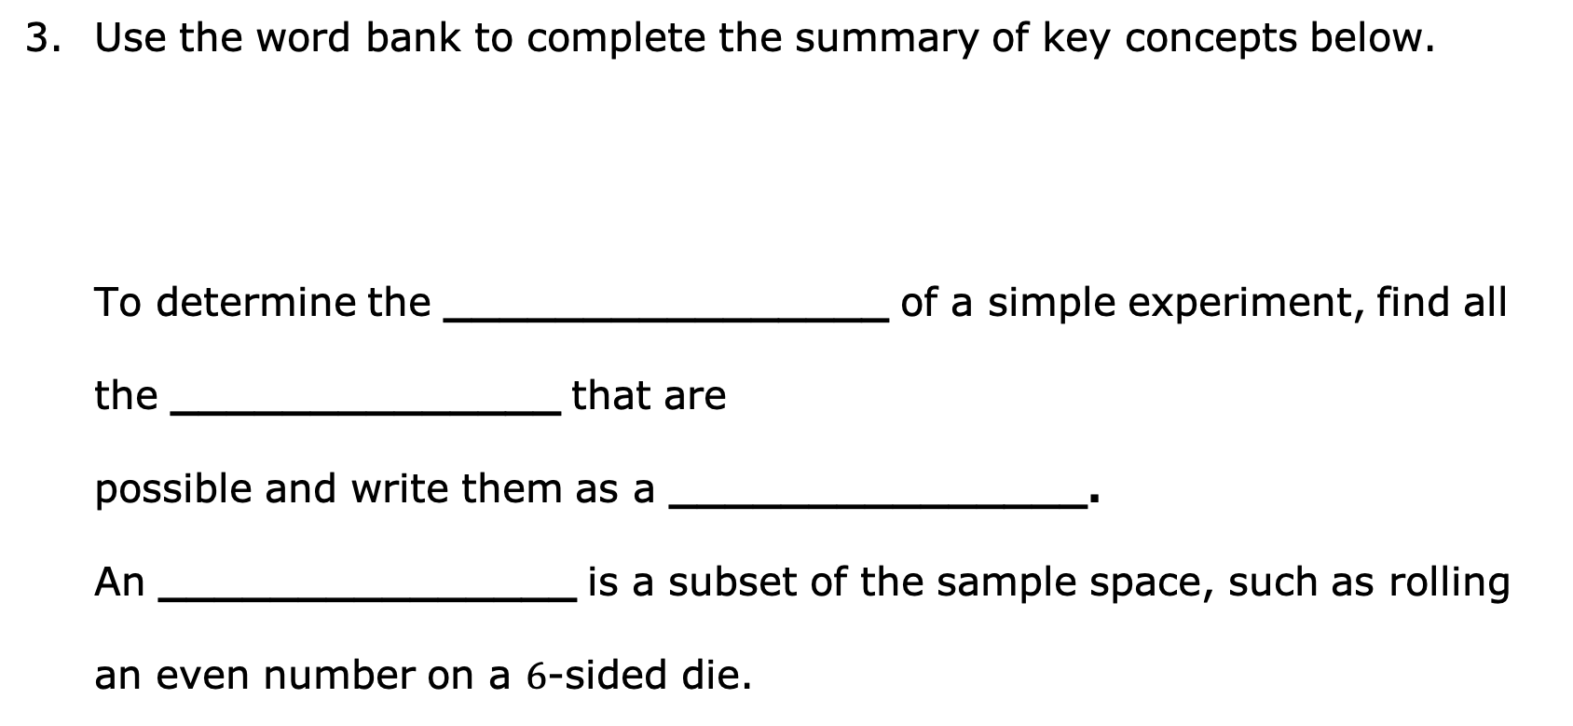
Use the word bank to complete the summary of key concepts below.
To determine the ________________ of a simple experiment, find all the ______________ that are possible and write them as a _______________. An _______________ is a subset of the sample space, such as rolling an even number on a $6$-sided die.
event outcomes sample space set
volume 2, pg. 403

Slide 16

Exploration
volume 2, pg. 404

Slide 17

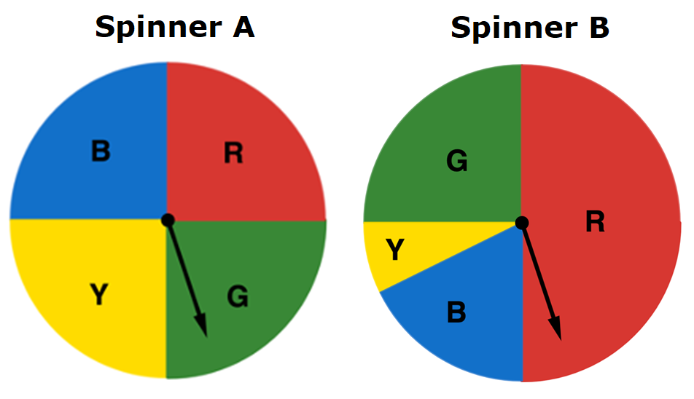
15.1.3 Exploration: Digging Deeper into Outcomes
Two spinners are shown.
volume 2, pg. 404

Slide 18
Work with your partner to compare and contrast the features of the two spinners.
One of the spinners is considered a fair spinner. Complete the sentence by selecting the fair spinner and writing an explanation.
is the fair spinner because ___________
_____________________________________________.
Similarities | Differences
Spinner A
Spinner B
volume 2, pg. 404

Slide 19

Activity
volume 2, pg. 404

Slide 20

15.1.4 Activity: Gallery Walk
Work with your partner to determine the sample space for each game and whether the game is fair. Fill in the chart with your answers.
Game Name | Sample Space | Is it fair?
Skee-Ball
Card Draw
volume 2, pg. 404

Slide 21
Game Name | Sample Space | Is it fair?
Prize Wheel
Rubber Ducks
volume 2, pg. 404

Slide 22
Which game has the largest sample space?
Discuss with your partner which game’s sample space was the most difficult to determine.
Carnivals include many games similar to these. What do you notice about the fairness of such games?
volume 2, pg. 405

Slide 23
Find another pair of partners to form a group of four. Compare your responses on whether each game is fair and discuss your reasoning. Record one similarity and one difference you notice in your reasoning.
Future lessons in this unit will explore probabilities with fair coins, fair dice, and fair spinners. Describe what you think it means for a coin, a die, or a spinner to be fair.
Similarity | Difference
volume 2, pg. 405

Slide 24

Wrap-Up
volume 2, pg. 405

Slide 25
15.1.5 Wrap-Up: Reflection
Complete each statement based on your understanding at this point.
I am still unsure about ____________________________ _______________________________________________ ______________________________________________.
One question I have that will help me better understand is _______________________________________________ ______________________________________________?
volume 2, pg. 405

